Slide 1
Instructions

Slide 2
Get the Files from Github
https://github.com/fmang83api/Homework
-Clone or Download Folder
-Powershell Script
-Unzip the .zip file to get the homework.bak. That file is used to restore the database.
-Homework Instruction Powerpoint Slide

Slide 3
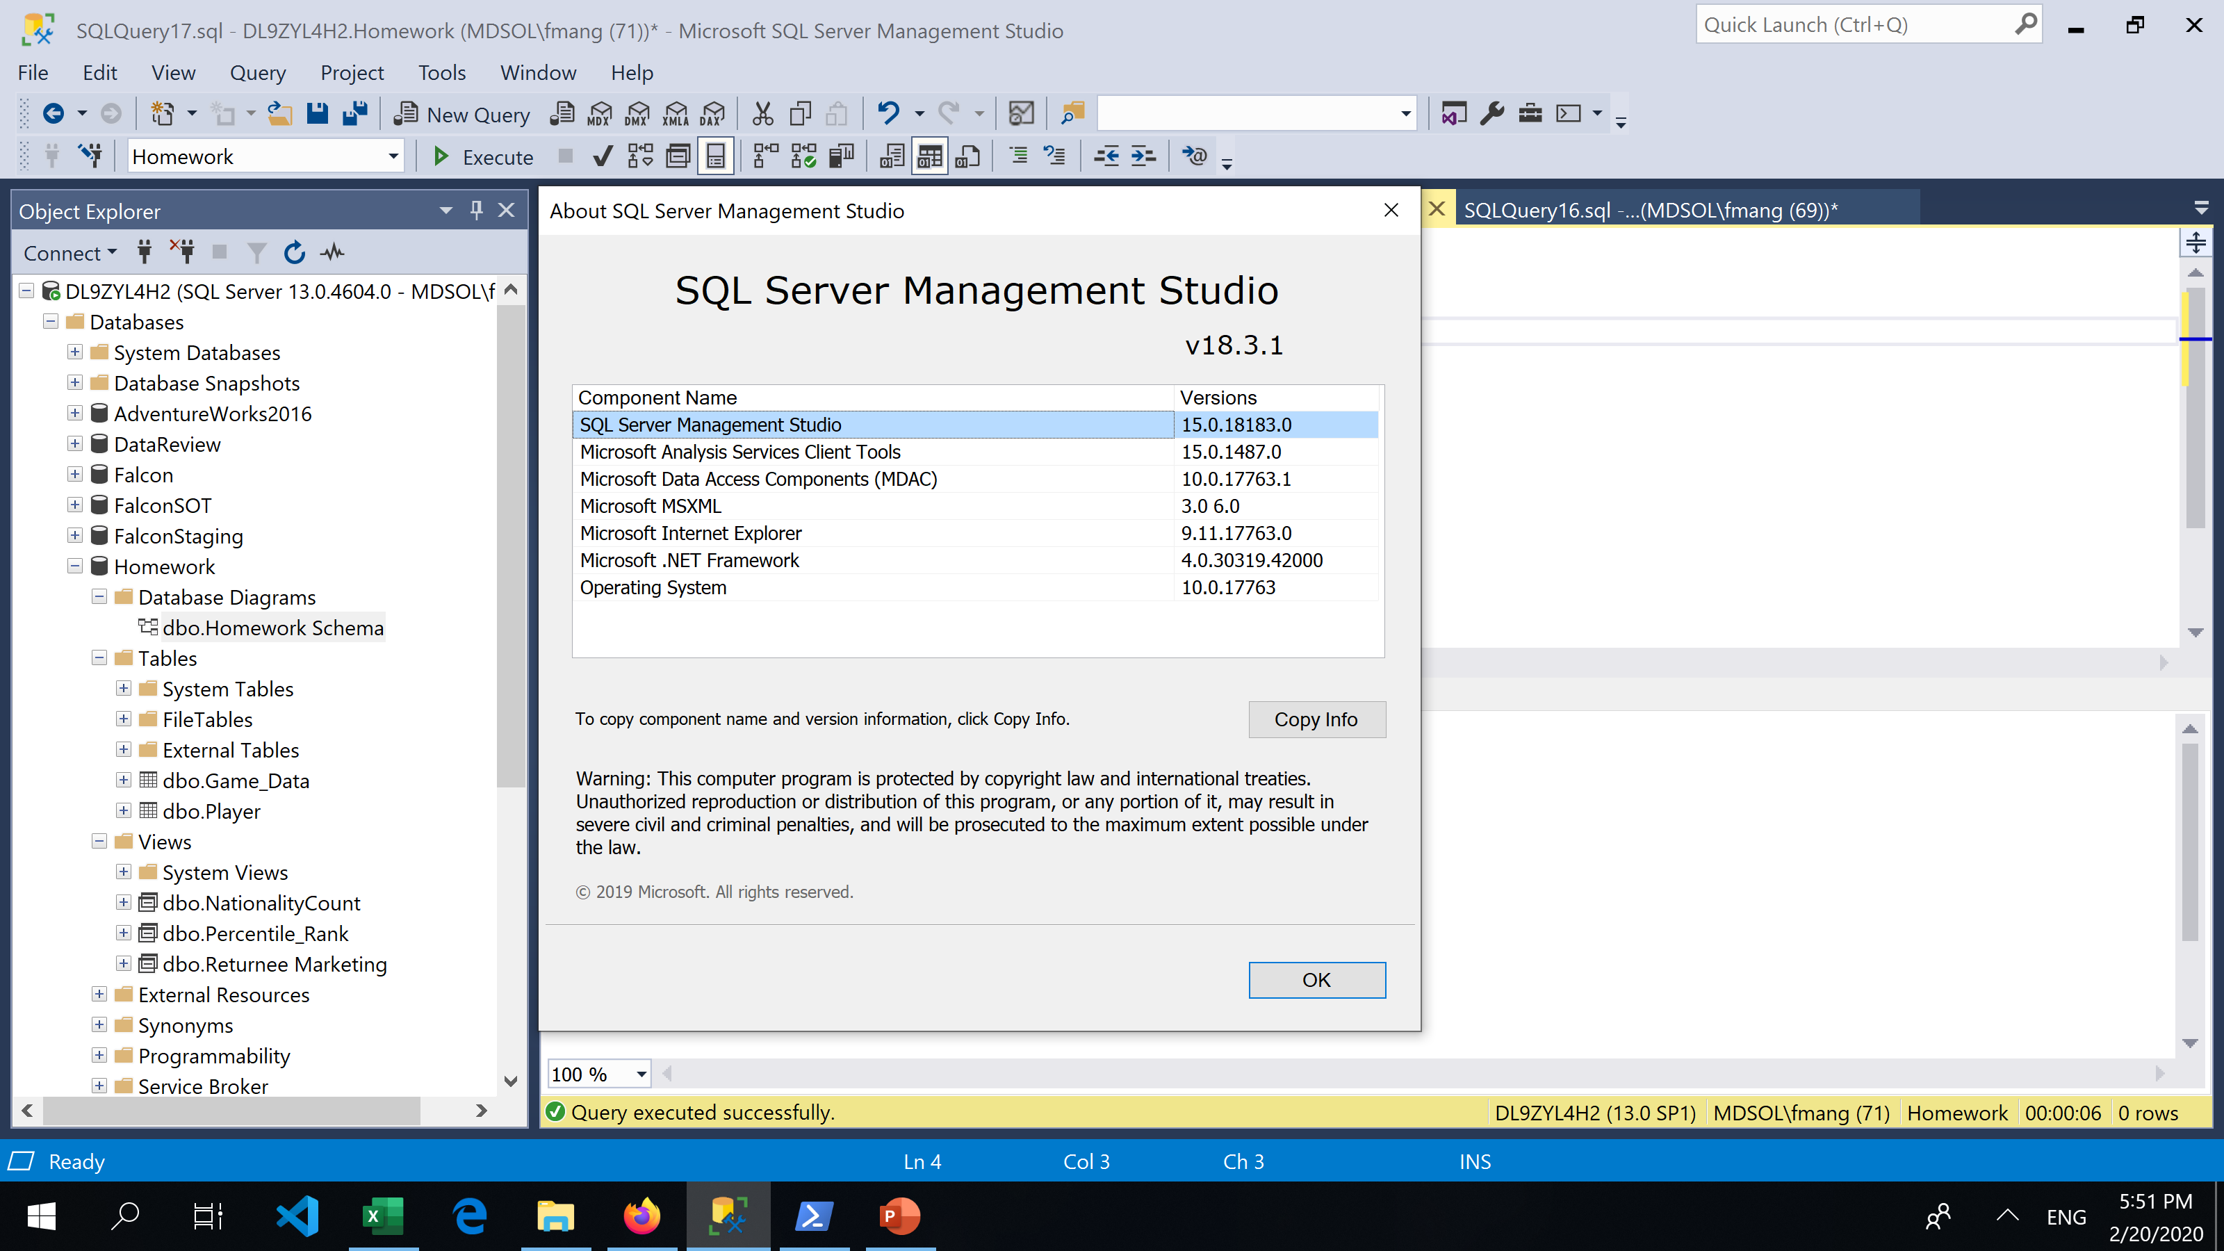
Microsoft SqlServer Info
Here are the MS Server Specs.

Slide 4
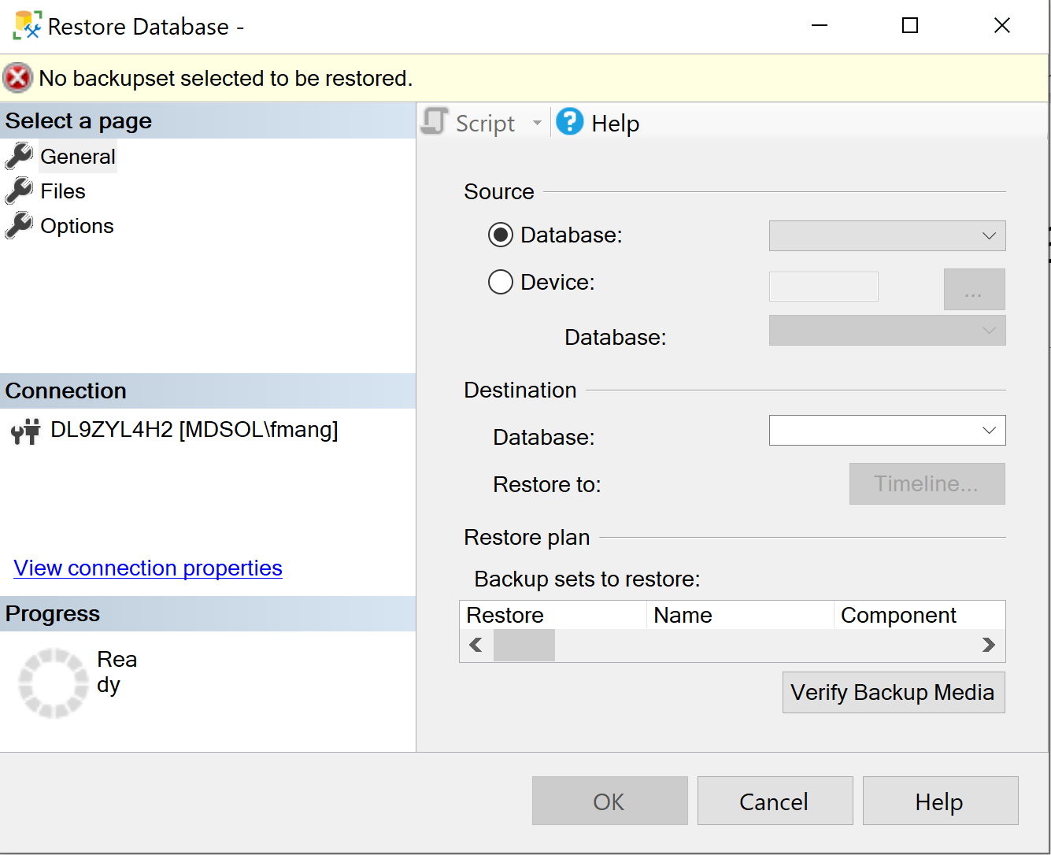
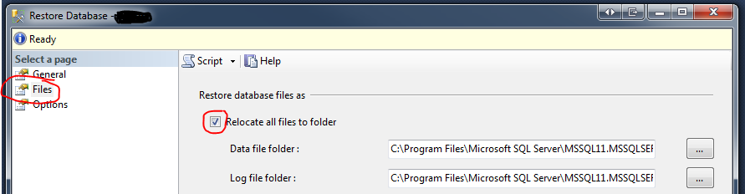
Microsoft SqlServer Restore Database
Right click on Databases. Select Restore Database, then device, then the path where the homework.bak is downloaded to.
If fail to restore., try to select files, then click on relocate all files to folder, then ok

Slide 5
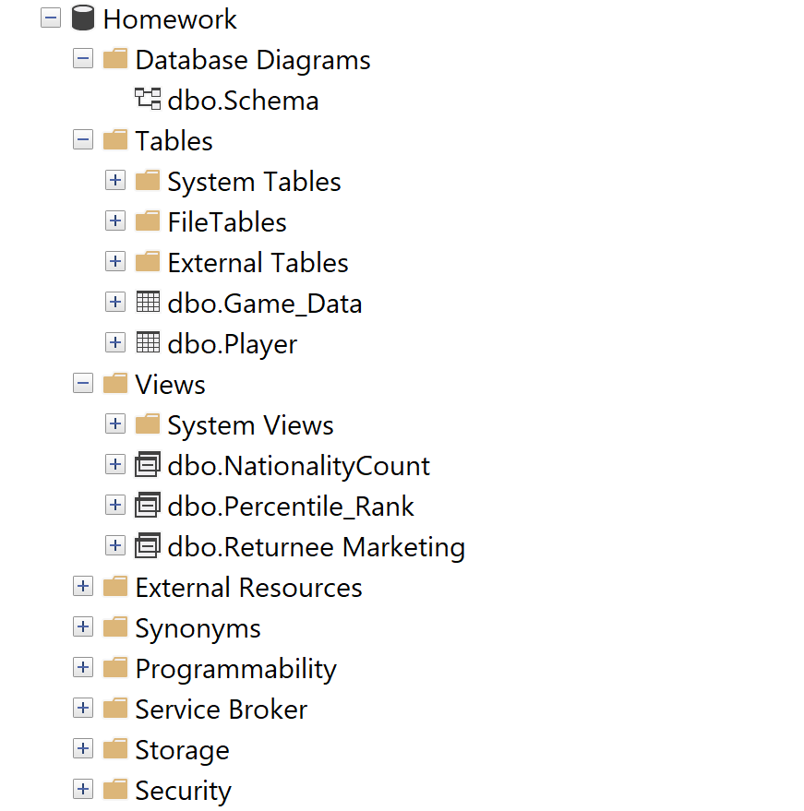
Ensure Database is restored……
Since the database is restored, the data is already loaded.
To test the powershell script
Run the following T-Sql commands to remove data.
delete FROM [dbo].[Game_Data]
delete from [dbo].[Player]

Slide 6
Execute Powershell
Open the script with notepad or powershell ISE. Alter the script to your database server configuration (Data Source=‘name of sql server’;Catalog=Homework;Integrated Security=True’). Download the csv to your local path (line 103), then import csv from that path (line 107). Save the updates.
Put the database server connection string at line 201. Data Source is the local database server name. Alternatively, get the connection string thru server connection in Visual Studio. Go to Server Explorer, right click on data connections, select add connection.

Slide 7
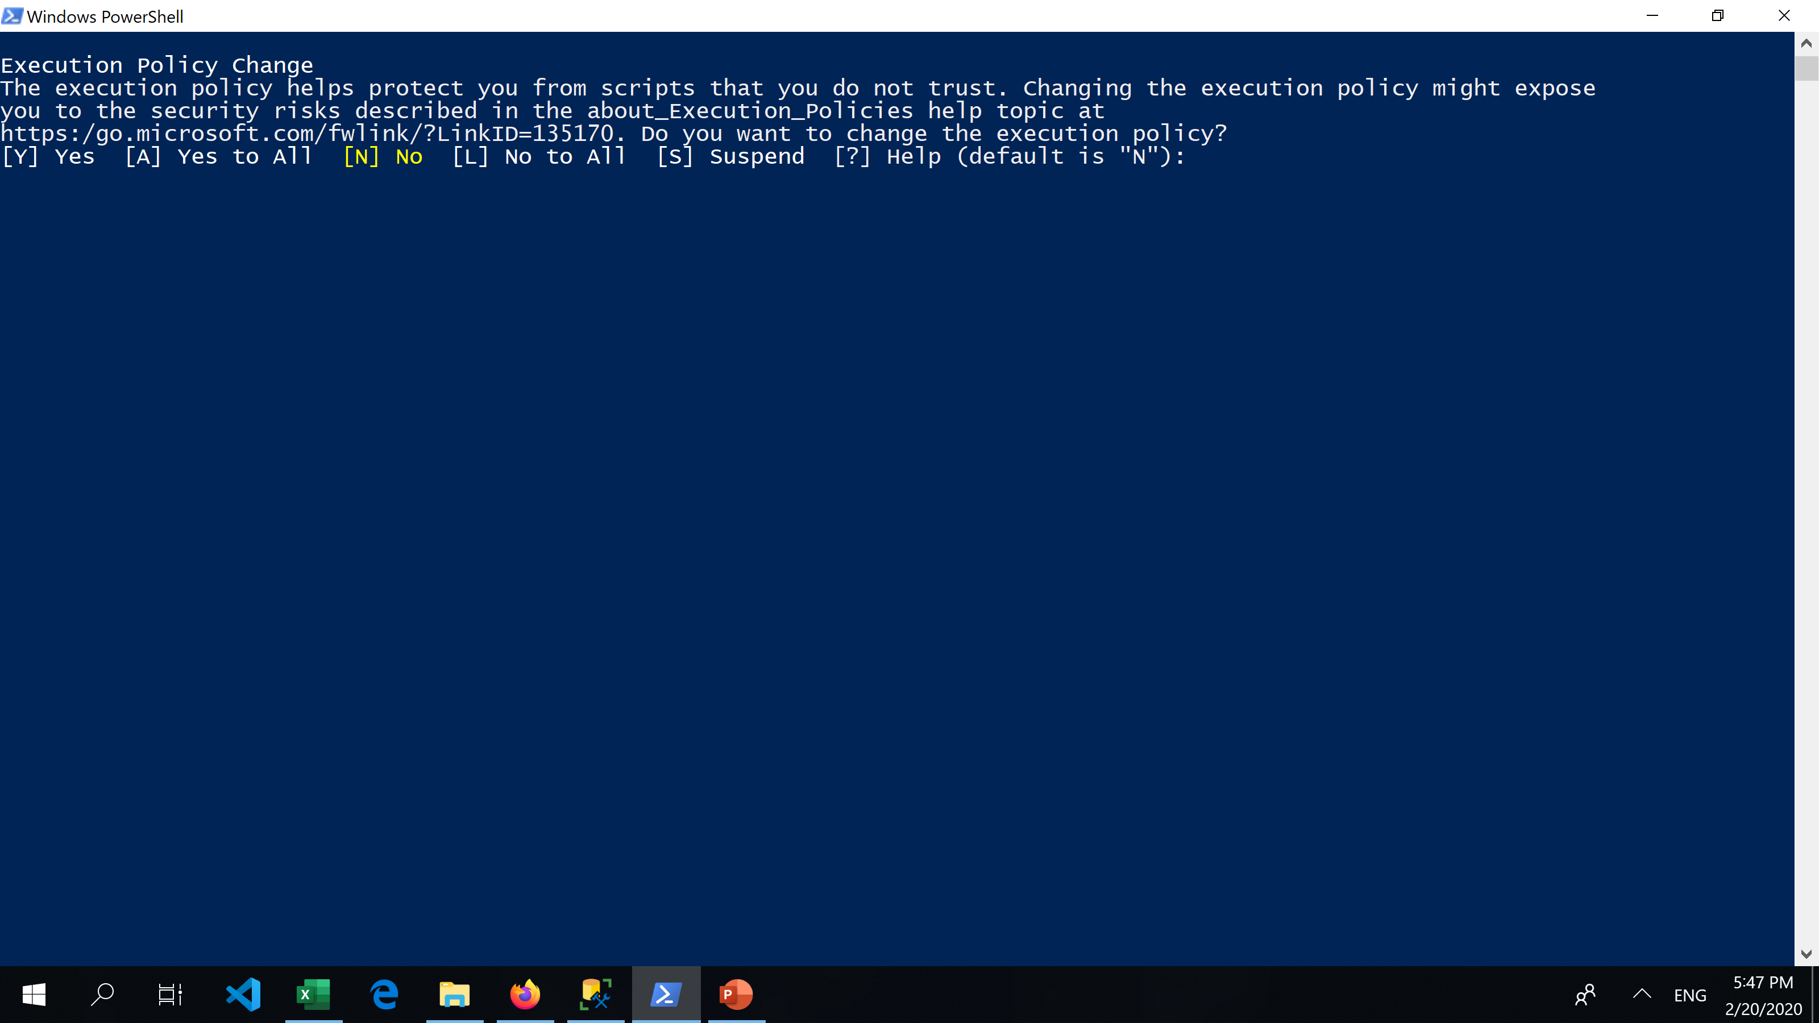
Execute Powershell
Right click on Powershell script, select run with Powershell, N to Execution Policy Change.

Slide 8
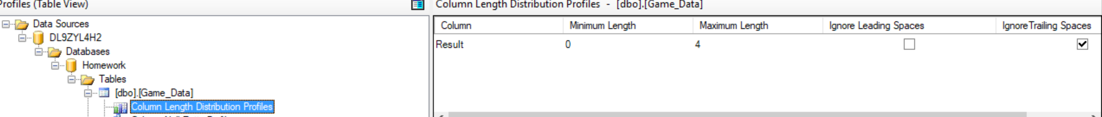
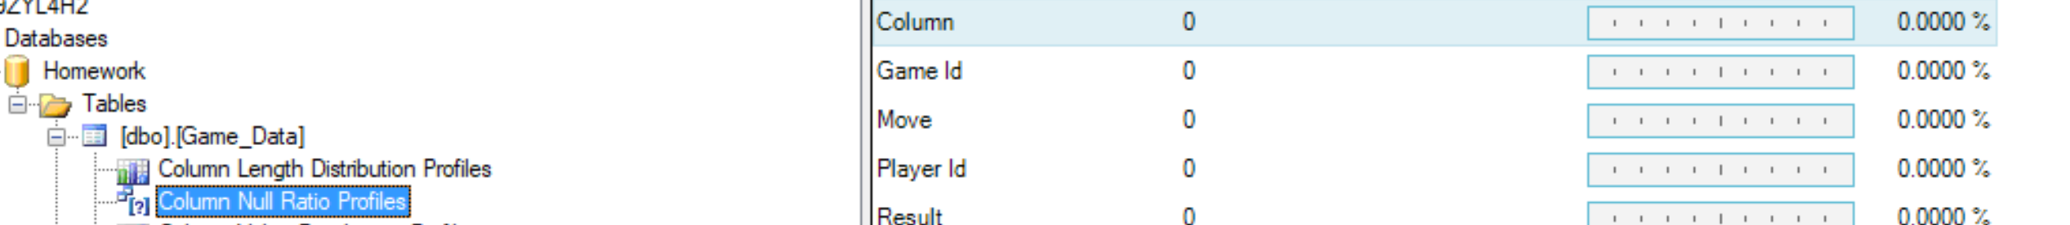
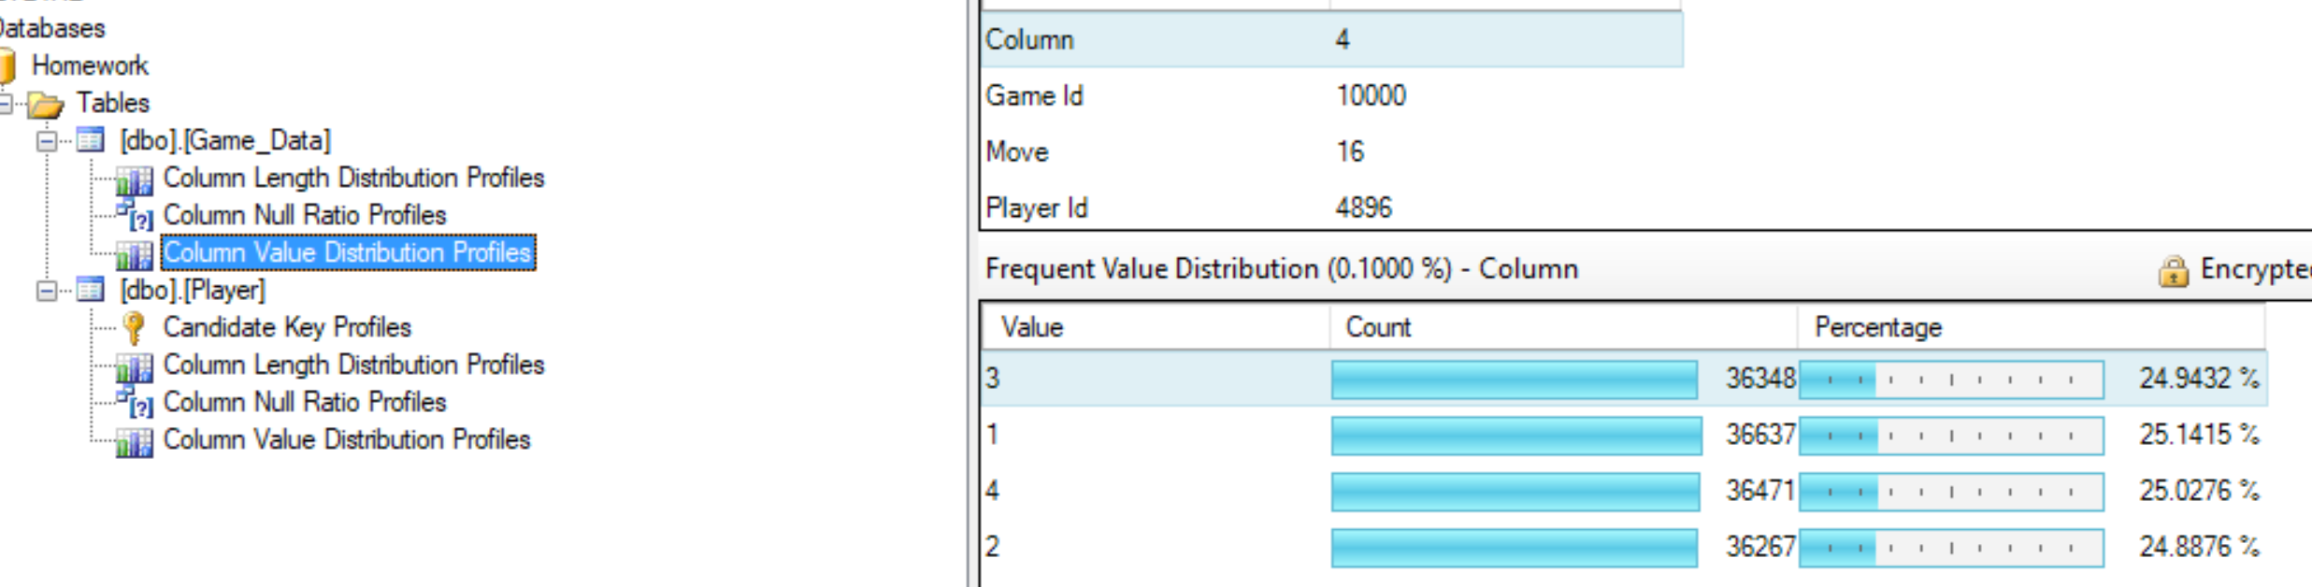
Data Profile Screeenshots
I did a data profile of the datasets to see if column frequent values, Length Distribution, key profile, null values to ensure I can build a column type that is most suitable to the dataset.

Slide 9
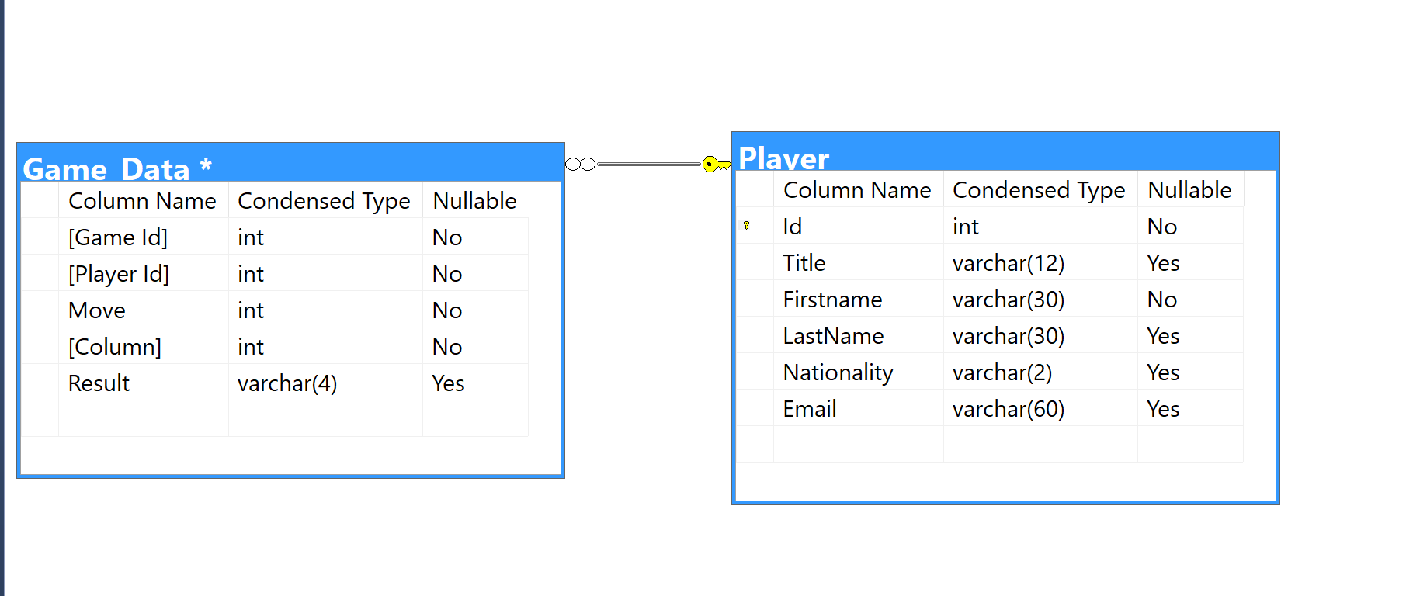
Schema

